Slide 1
Safe Beginnings
Fall Prevention

Slide 2
Safe Beginnings is brought to you by:
Innovative Partnerships Program: Sierra-Sacramento Region
A 14-County Collaborative of Child Abuse Prevention Councils
In Partnership with:
The Office of Child Abuse Prevention
The Child Abuse Prevention Council of Sacramento
Funded, in part, by California Department of Public Health Kids’ Plates Program

Slide 3
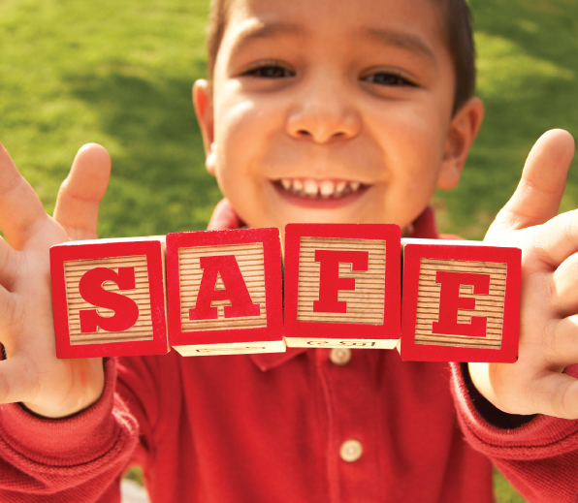
Purpose: How to Keep your Child Safe from Falls
We are going to talk about:
Child Fall Injuries in California
Falls in the Home
Falls on the Go
When your Child Falls
Safety Reminders
Notes:
The purpose of this training is to provide information, tools, and resources to parents and caregivers of children age 0 to 5 that maximize safety and prevent unintentional injuries. By the end of this training, the participant will be informed as to how to prevent unintentional injuries due to falls both inside and outside the home.
Photo taken from:
https://www.kidcheck.com/blog/kidcheck-shares-safety-tips-vbs/

Slide 4
Child Fall Injuries in California
Non-Fatal Fall Injury Hospitalization in California, 2015
AGE GROUP | TOTAL
<1 | 429
1-4 | 1,440
5-9 | 1,604
10-14 | 1,028
15-19 | 993
Source: http://epicenter.cdph.ca.gov/ReportMenus/CallReportingServicesDataSummaries.ashx?reportID=11&reportDataID=2&DataYear=2015&countyList=101&OutputFormat=3
Notes:
The table above shows non-fatal fall injury hospitalizations by age group, 2015
In California, falls are the leading cause of unintentional non-fatal injuries among children and youth ages 0 to 14, and ranks 2nd among the 15-19 age group
Information in table taken from: http://epicenter.cdph.ca.gov/ReportMenus/CallReportingServicesDataSummaries.ashx?reportID=11&reportDataID=2&DataYear=2015&countyList=101&OutputFormat=3

Slide 5
Child Fall Injuries in [Your County]
Include any county-specific data here.
Check these sources to find data for your county
http://epicenter.cdph.ca.gov/
https://www.kidsdata.org/
Sources:

Slide 6
Falls in the Home
Common Causes of Falls in the Home among Children Age 0-5 are:
Stairs
Windows
Baby Equipment & Furniture
Bathtubs & Other Slippery Surfaces
Notes:
These are the common causes and areas of falls in the home among children ages 0-5.
Highlights from Preventing Pediatric Falls Video to support the prevalence of falls in these areas:
The most severe child fall injuries are from windows, baby walkers, and playground equipment
In the past 2 decades, 100,000 children have been injured in falls
Every day, 14 children are injured due to falls from windows
Video link: https://newsnetwork.mayoclinic.org/discussion/mayo-clinic-trauma-expert-preventing-pediatric-falls/

Slide 7
Falls at Home: Prevention
Source: https://parachute.ca/en/injury-topic/fall-prevention-for-children/
Notes:
Link to video:
https://parachute.ca/en/injury-topic/fall-prevention-for-children/
Additional video, Preventing Pediatric Falls:
https://newsnetwork.mayoclinic.org/discussion/mayo-clinic-trauma-expert-preventing-pediatric-falls/
Preventing Pediatric Falls Video Highlights:
The most severe child fall injuries are from windows, baby walkers, and playground equipment
In the past 2 decades, 100,000 children have been injured in falls
Every day, 14 children are injured due to falls from windows

Slide 8
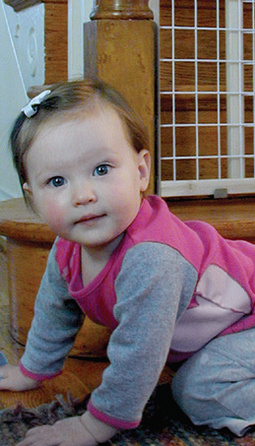
Falls from Stairs
Every 6 minutes, a child under age 5, is hurt falling down the stairs
In 10 years, nearly 1 million children under age 5 were taken to the hospital after a fall from stairs
More than 30% were babies (12 months and younger)
Sources:
https://www.cbsnews.com/news/stair-injuries-report-every-six-minutes-us-child-falls/
https://well.blogs.nytimes.com/2012/03/12/stairs-at-home-remain-a-childhood-hazard/
https://www.stanfordchildrens.org/en/topic/default?id=falls--injury-statistics-and-incidence-rates-90-P02974
Notes:
Every 6 minutes, an American child under the age of 5 falls down the stairs and is taken to the hospital
Between 1999 and 2008, an estimated 932,000 children under the age of 5 were taken to hospitals for stair-related falls
Of the 932,000 children injured on staircases, 32% were babies 12 months and younger
Babies are more likely to fall from stairs
To emphasize bullet #2:
This is nearly 100,000 children each year
Information taken from:
https://www.cbsnews.com/news/stair-injuries-report-every-six-minutes-us-child-falls/
https://well.blogs.nytimes.com/2012/03/12/stairs-at-home-remain-a-childhood-hazard/
https://www.stanfordchildrens.org/en/topic/default?id=falls--injury-statistics-and-incidence-rates-90-P02974
Photo taken from:
https://www.safekids.org/safetytips/field_risks/falls/field_type/tip

Slide 9
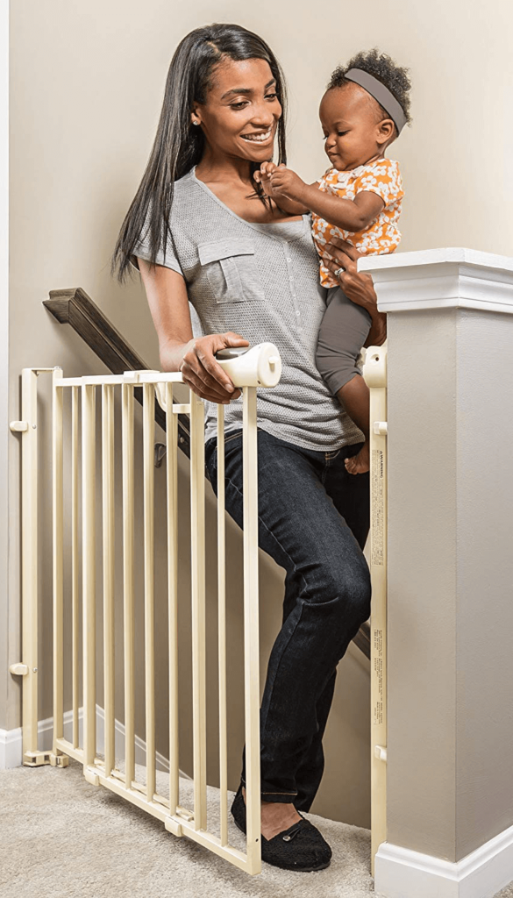
Falls from Stairs: Prevention
Attach gates to both ends of stairs
Openings between rails should be no more than 2.3 inches
Keep stairs clean and free of clutter
Supervise children around stairs, even with gates
Teach children to hold onto railings and carefully step one at a time
Place guards on railings if a child can fit through
Lock or use doorknob covers on doors that lead to staircases, such as basements
Sources:
https://www.cbsnews.com/news/stair-injuries-report-every-six-minutes-us-child-falls/
https://well.blogs.nytimes.com/2012/03/12/stairs-at-home-remain-a-childhood-hazard/
https://www.stanfordchildrens.org/en/topic/default?id=falls--injury-statistics-and-incidence-rates-90-P02974
Notes:
Affix gates to both ends of stairs
- Openings between rails should be no more than 2.3 inches
- Avoid accordion style gates, as children’s heads could become stuck
Keep stairs clean and free of clutter
Always supervise children around stairs, even with gates, as children can climb up on gates and fall from an even greater height
Teach children to hold onto railings and carefully step one at a time
Place guards on banisters or railings if a child can fit through
Lock or use doorknob covers on doors that lead to staircases, such as basements
Information taken from:
https://www.cbsnews.com/news/stair-injuries-report-every-six-minutes-us-child-falls/
https://well.blogs.nytimes.com/2012/03/12/stairs-at-home-remain-a-childhood-hazard/
https://www.stanfordchildrens.org/en/topic/default?id=falls--injury-statistics-and-incidence-rates-90-P02974
Photo taken from:
https://www.lucieslist.com/guides/baby-proofing/baby-gates/

Slide 10
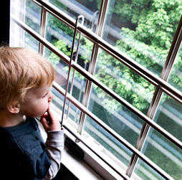
Window Falls
There are 12 deaths and 5,000 injuries from window falls of children (10 and under) each year
Children under 4 are at greatest risk of head injuries and death from window falls
This makes them 2x as likely to die from a window fall than older children
In 80% of cases a window screen was in place before the fall
Children most at risk of window falls are unsupervised boys under age 5
Sources:
https://www.unitypoint.org/blankchildrens/window-falls.aspx
https://www.stanfordchildrens.org/en/topic/default?id=falls--injury-statistics-and-incidence-rates-90-P02974
Notes:
The American Academy of Pediatrics reports that falls from windows account for 12 deaths and 5,000 injuries among children 10 and under each year
Children under 4 are at greatest risk to sustain head injuries, making them nearly twice as likely to die from a window fall than older children
A window screen was in place before the fall in 80% of cases
Children most at risk of window falls are boys under age 5 who are unsupervised at the time of the fall
Important: It is important to emphasize that while these rules are applicable to all homes and buildings, falls from second- and multi-story buildings are especially dangerous.
Information taken from:
https://www.unitypoint.org/blankchildrens/window-falls.aspx
https://www.stanfordchildrens.org/en/topic/default?id=falls--injury-statistics-and-incidence-rates-90-P02974
Photo taken from:
https://www.safekids.org/safetytips/field_risks/falls/field_type/tip

Slide 11
Window Falls: Prevention
Source: https://www.hannahgeneserfoundation.org/window-safety
Notes:
Prevention Practices:
-Install window guards that cover the lower part of the window but can be easily opened by older children and adults in case of an emergency
-Install window stops to prevent windows from opening more than 4 inches
-Most children age 5 and younger can fit through a 6-inch opening
-Keep windows closed and locked when not in use and/or when children are present
-If you have double-hung windows that open from both top and bottom, open from the top only
-Move furniture away from windows and discourage children from climbing near windows
-Remember: Window screens are designed to keep bugs out, not children in
Information taken from:
https://www.unitypoint.org/blankchildrens/window-falls.aspx
https://www.stanfordchildrens.org/en/topic/default?id=falls--injury-statistics-and-incidence-rates-90-P02974
Video taken from:
https://www.hannahgeneserfoundation.org/window-safety
Notes of Importance:
1. While these rules are applicable to all homes and buildings, falls from second- and multi-story buildings are especially dangerous.
2. Be aware that children will eventually develop the strength and dexterity to open windows.

Slide 12
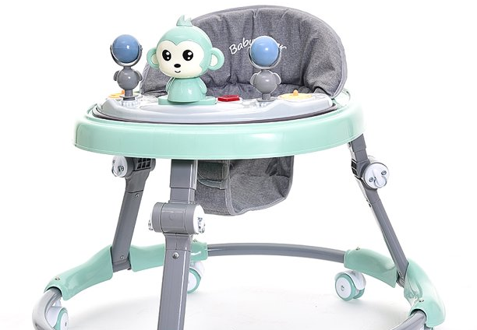
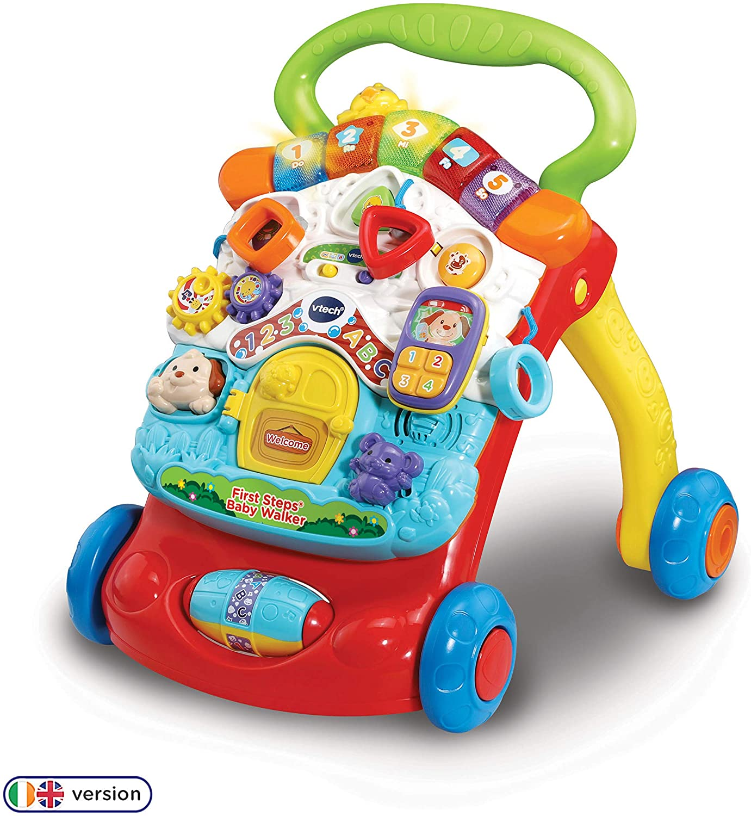
Baby Equipment & Furniture Falls
The American Academy of Pediatrics has called for a ban on baby walkers. Baby walkers do not have safety features to prevent falls, so do not use them.
In 2015, over 65,000 children, 5 years old and younger, were treated in emergency rooms for injuries from nursery products
Two-thirds of the injuries were from falls from cribs/mattresses, highchairs, infant/car seat carriers, and strollers.
9,000 children are injured in baby walker-related injuries each year
Children sustain head or neck injuries in over 90% of baby walker-related injuries
More than 70% of injuries were from falling down stairs in a walker
Sources:
https://www.cpsc.gov/s3fs-public/Nursery%20Products%20Annual%20Report%202016.pdf
https://www.cnn.com/2018/09/17/health/infant-walkers-injury-parenting/index.html
https://pediatrics.aappublications.org/content/142/4/e20174332
Notes:
In 2015, approximately 65,800 children ages 5 and younger were treated in emergency rooms for injuries associated with nursery products
Cribs/mattresses, highchairs, infant/car seat carriers, and strollers were associated with two-thirds of total estimated injuries, with fall being the leading cause of injury
9,000 children are injured in baby walker-related injuries each year in the United States
In one study of walker-related injuries, children sustained head or neck injuries in over 90% of cases, with 74.1% of injuries sustained from falling down the stairs in a walker
Additional Points on Baby Walkers:
-Baby walkers are discouraged by the American Academy of Pediatrics
-As an alternative, use a stationary activity saucer or activity center to promote movement
Information taken from:
https://www.cpsc.gov/s3fs-public/Nursery%20Products%20Annual%20Report%202016.pdf
https://www.cnn.com/2018/09/17/health/infant-walkers-injury-parenting/index.html
https://pediatrics.aappublications.org/content/142/4/e20174332
Photos taken from:
https://www.amazon.com/First-Steps-Baby-Walker-Yellow/dp/B07B8RY41D
https://www.walmart.com/ip/Baby-Walker-Anti-Rollover-Learning-Walking-Toy-Car-Free-Installation-for-Baby-6-18-Months-24in-35in-Toy-Monkey-Green/351675269

Slide 13
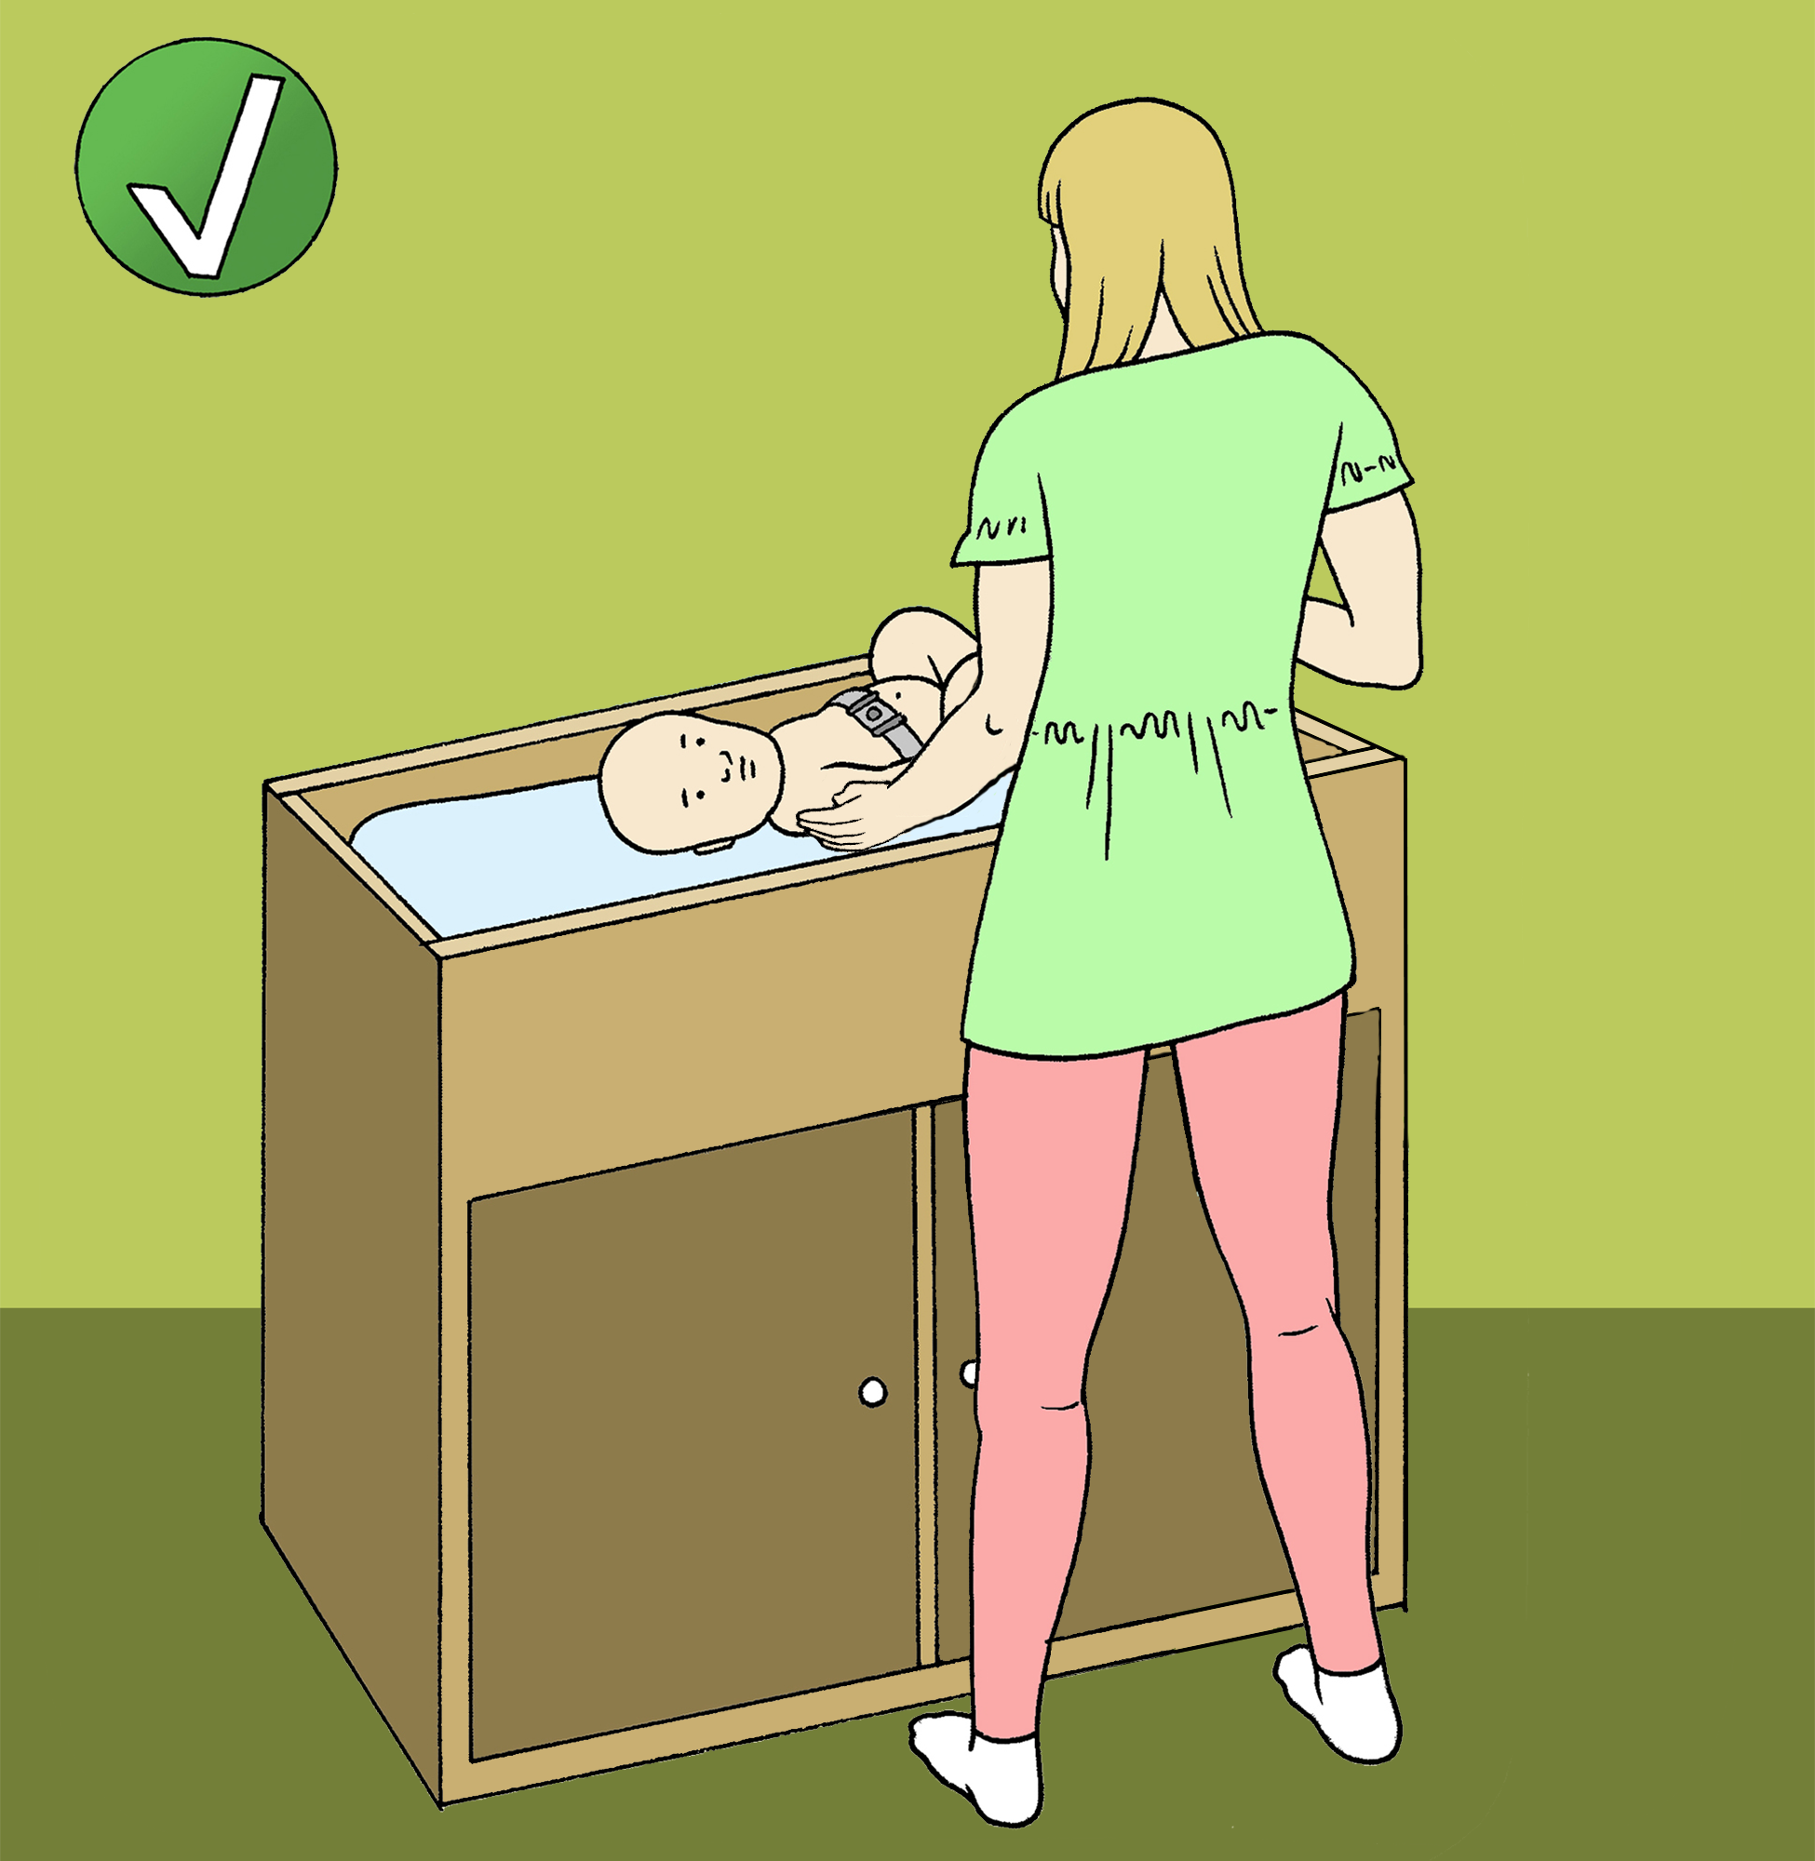
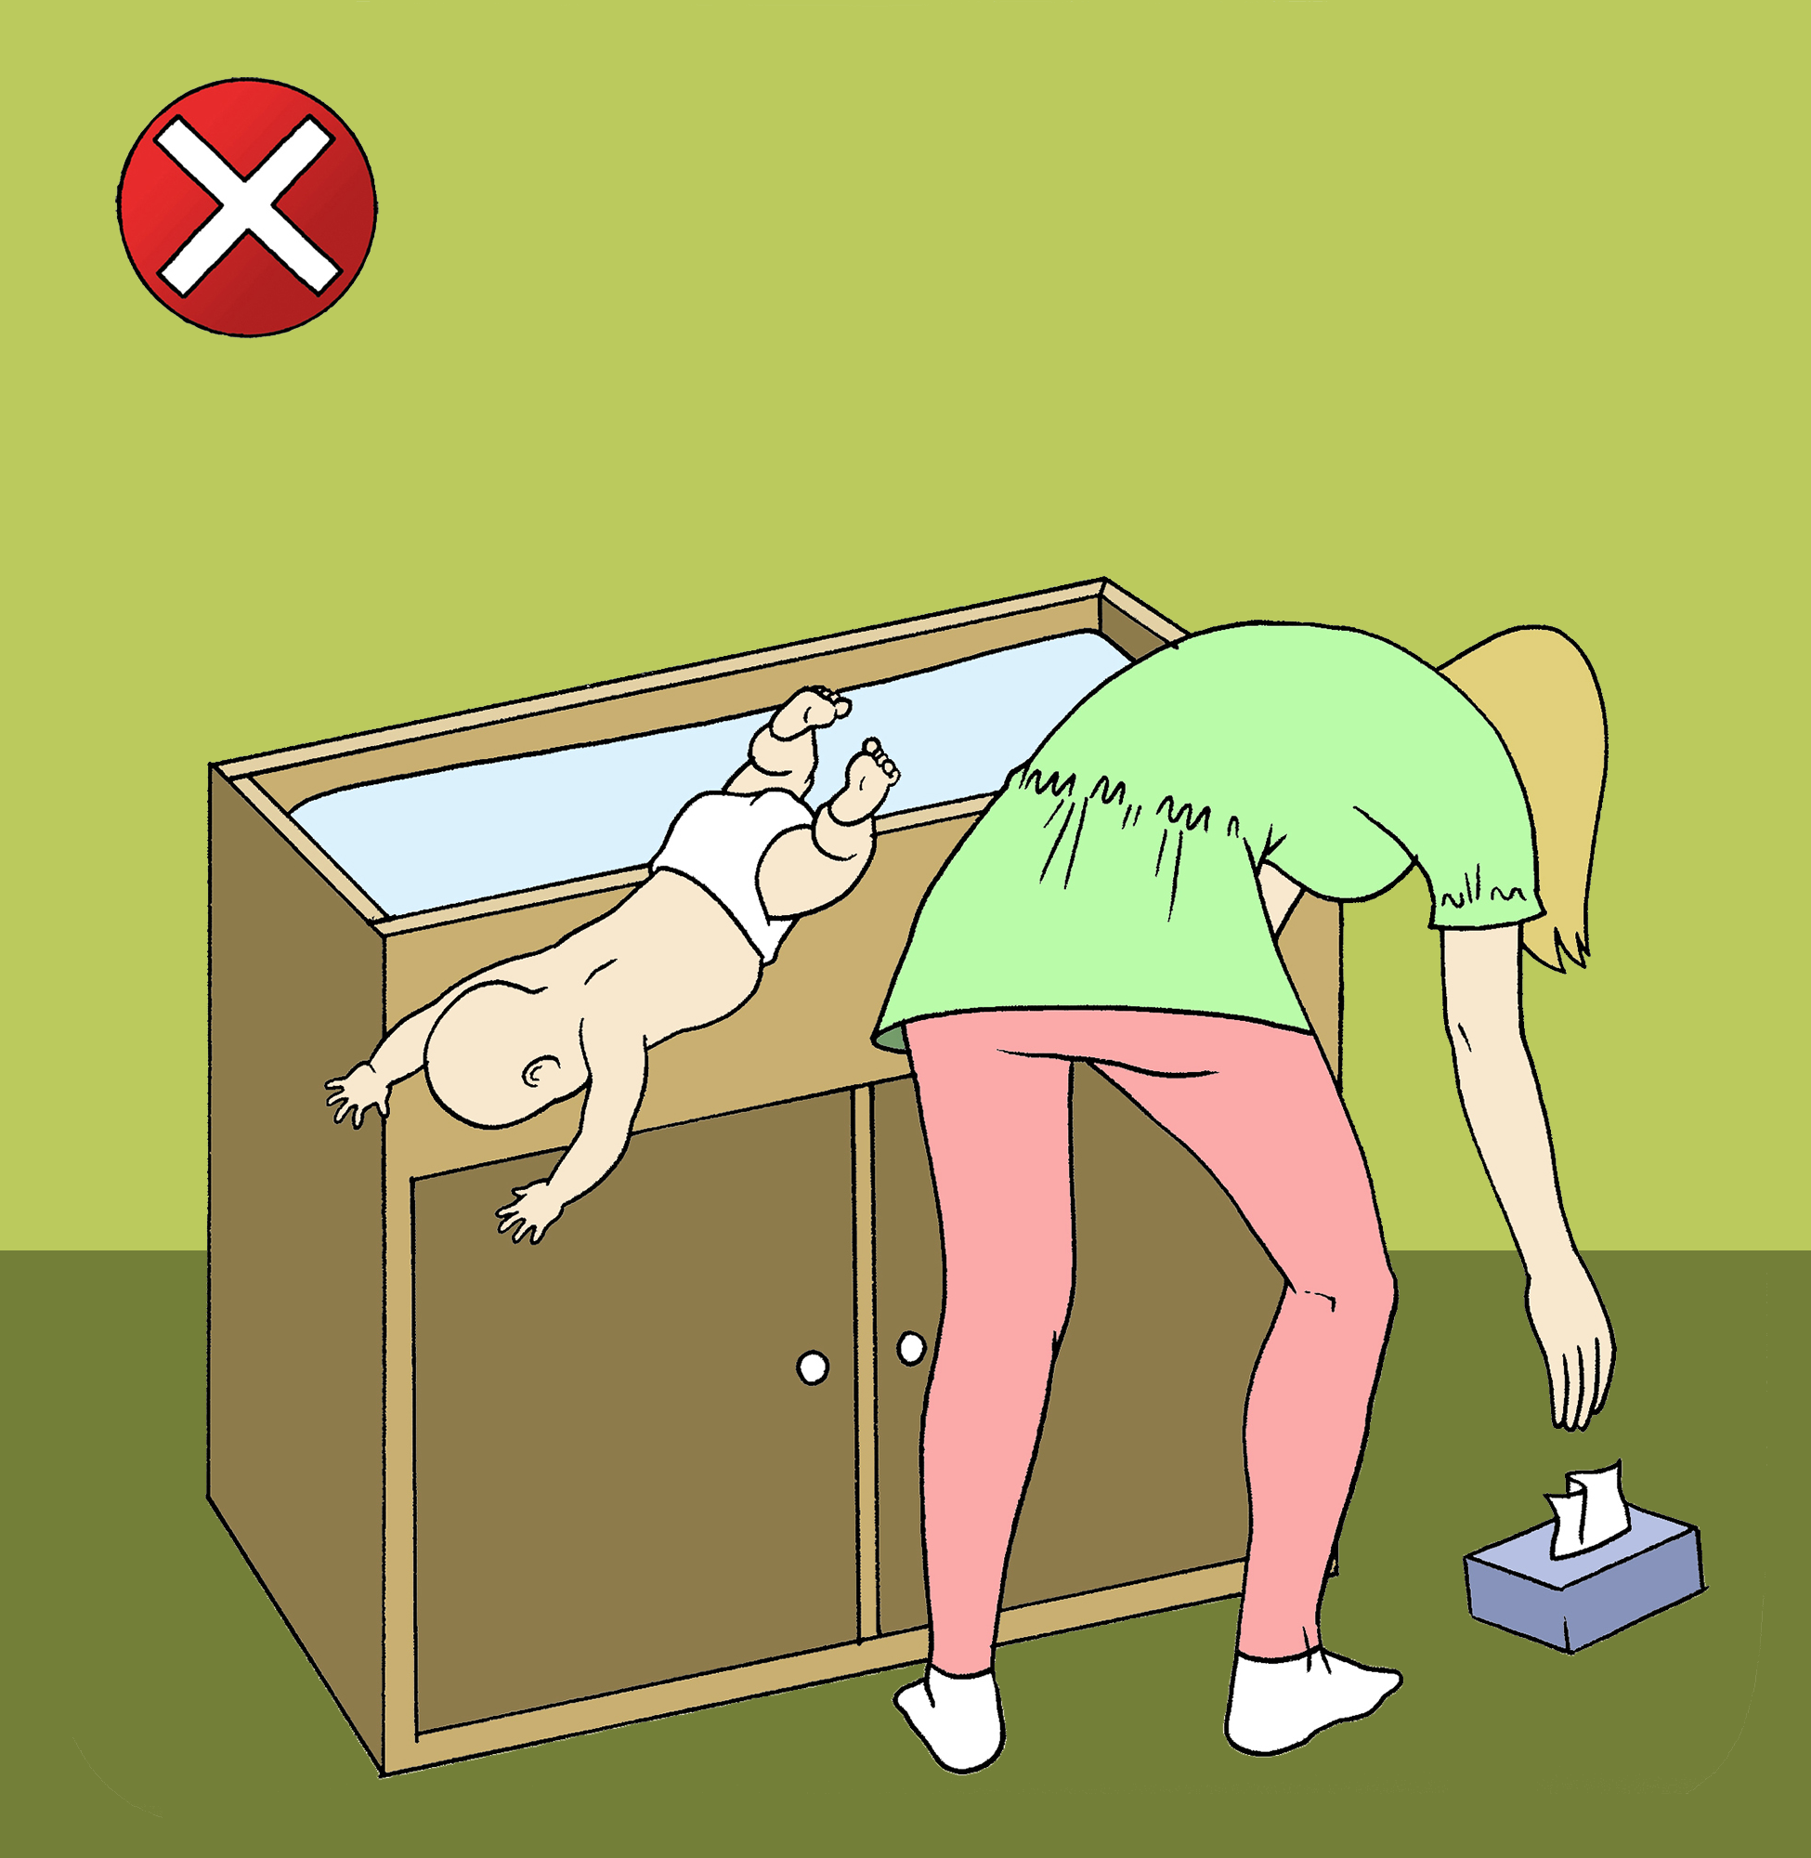
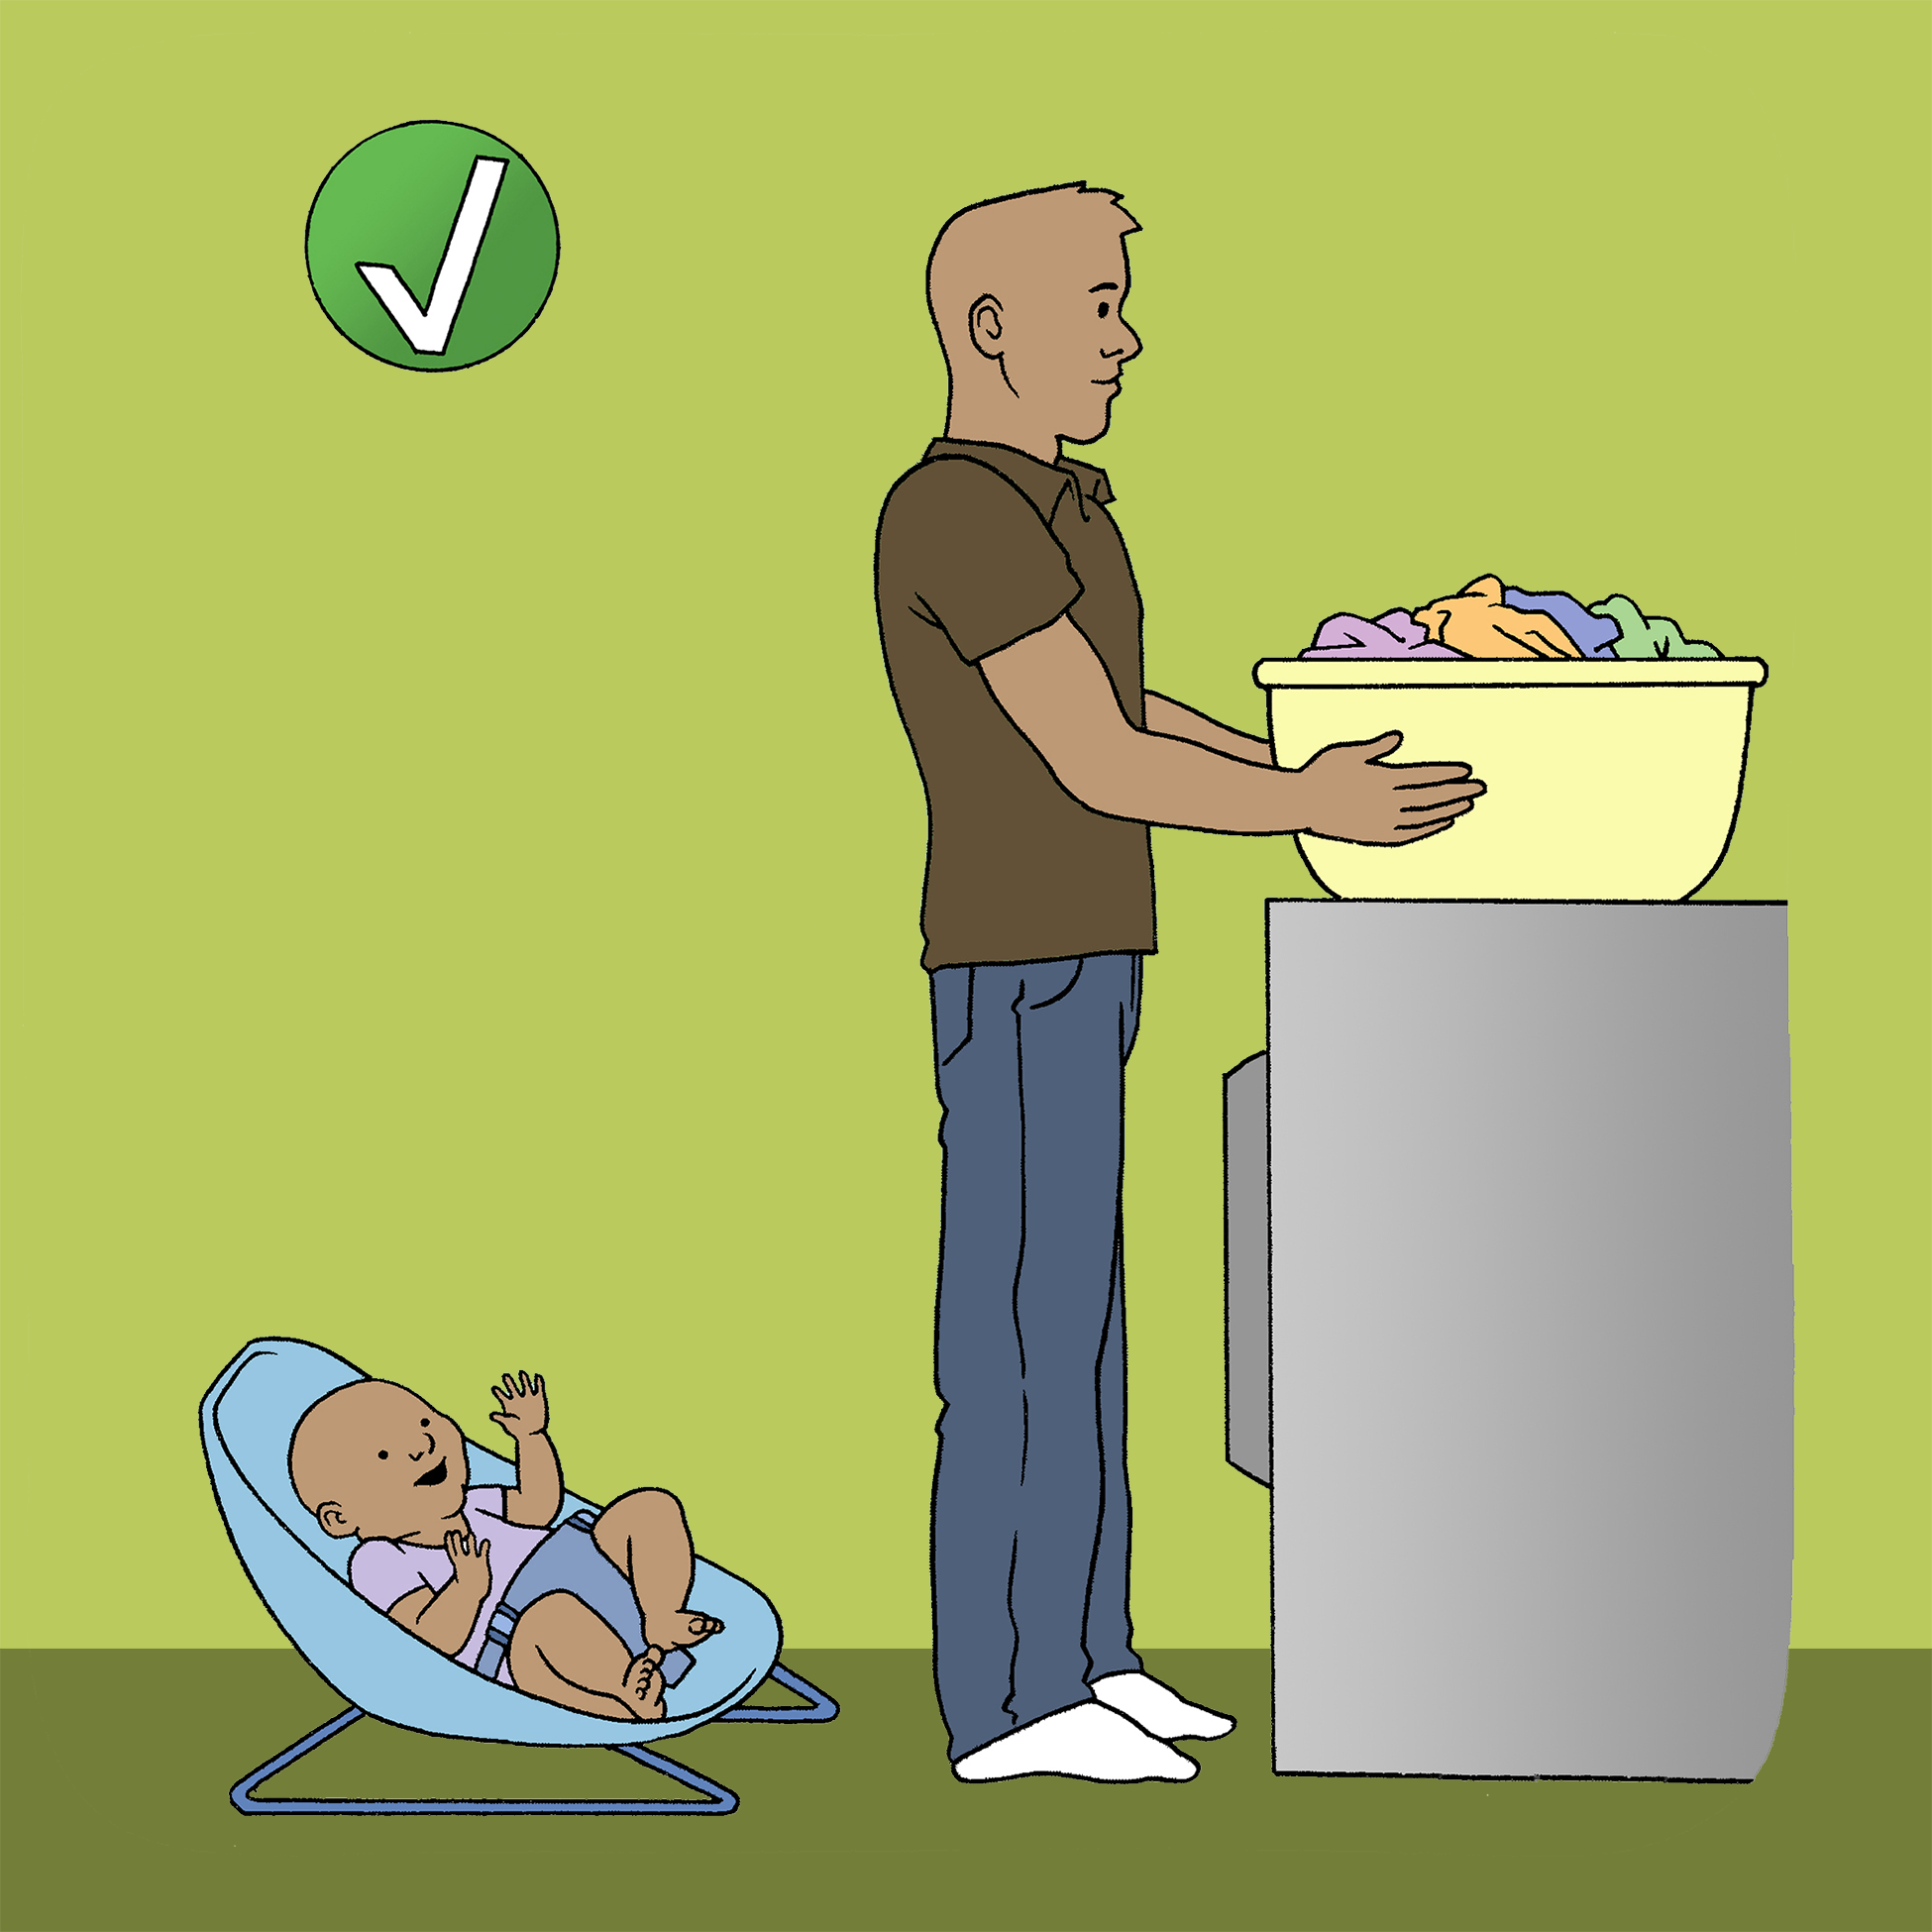
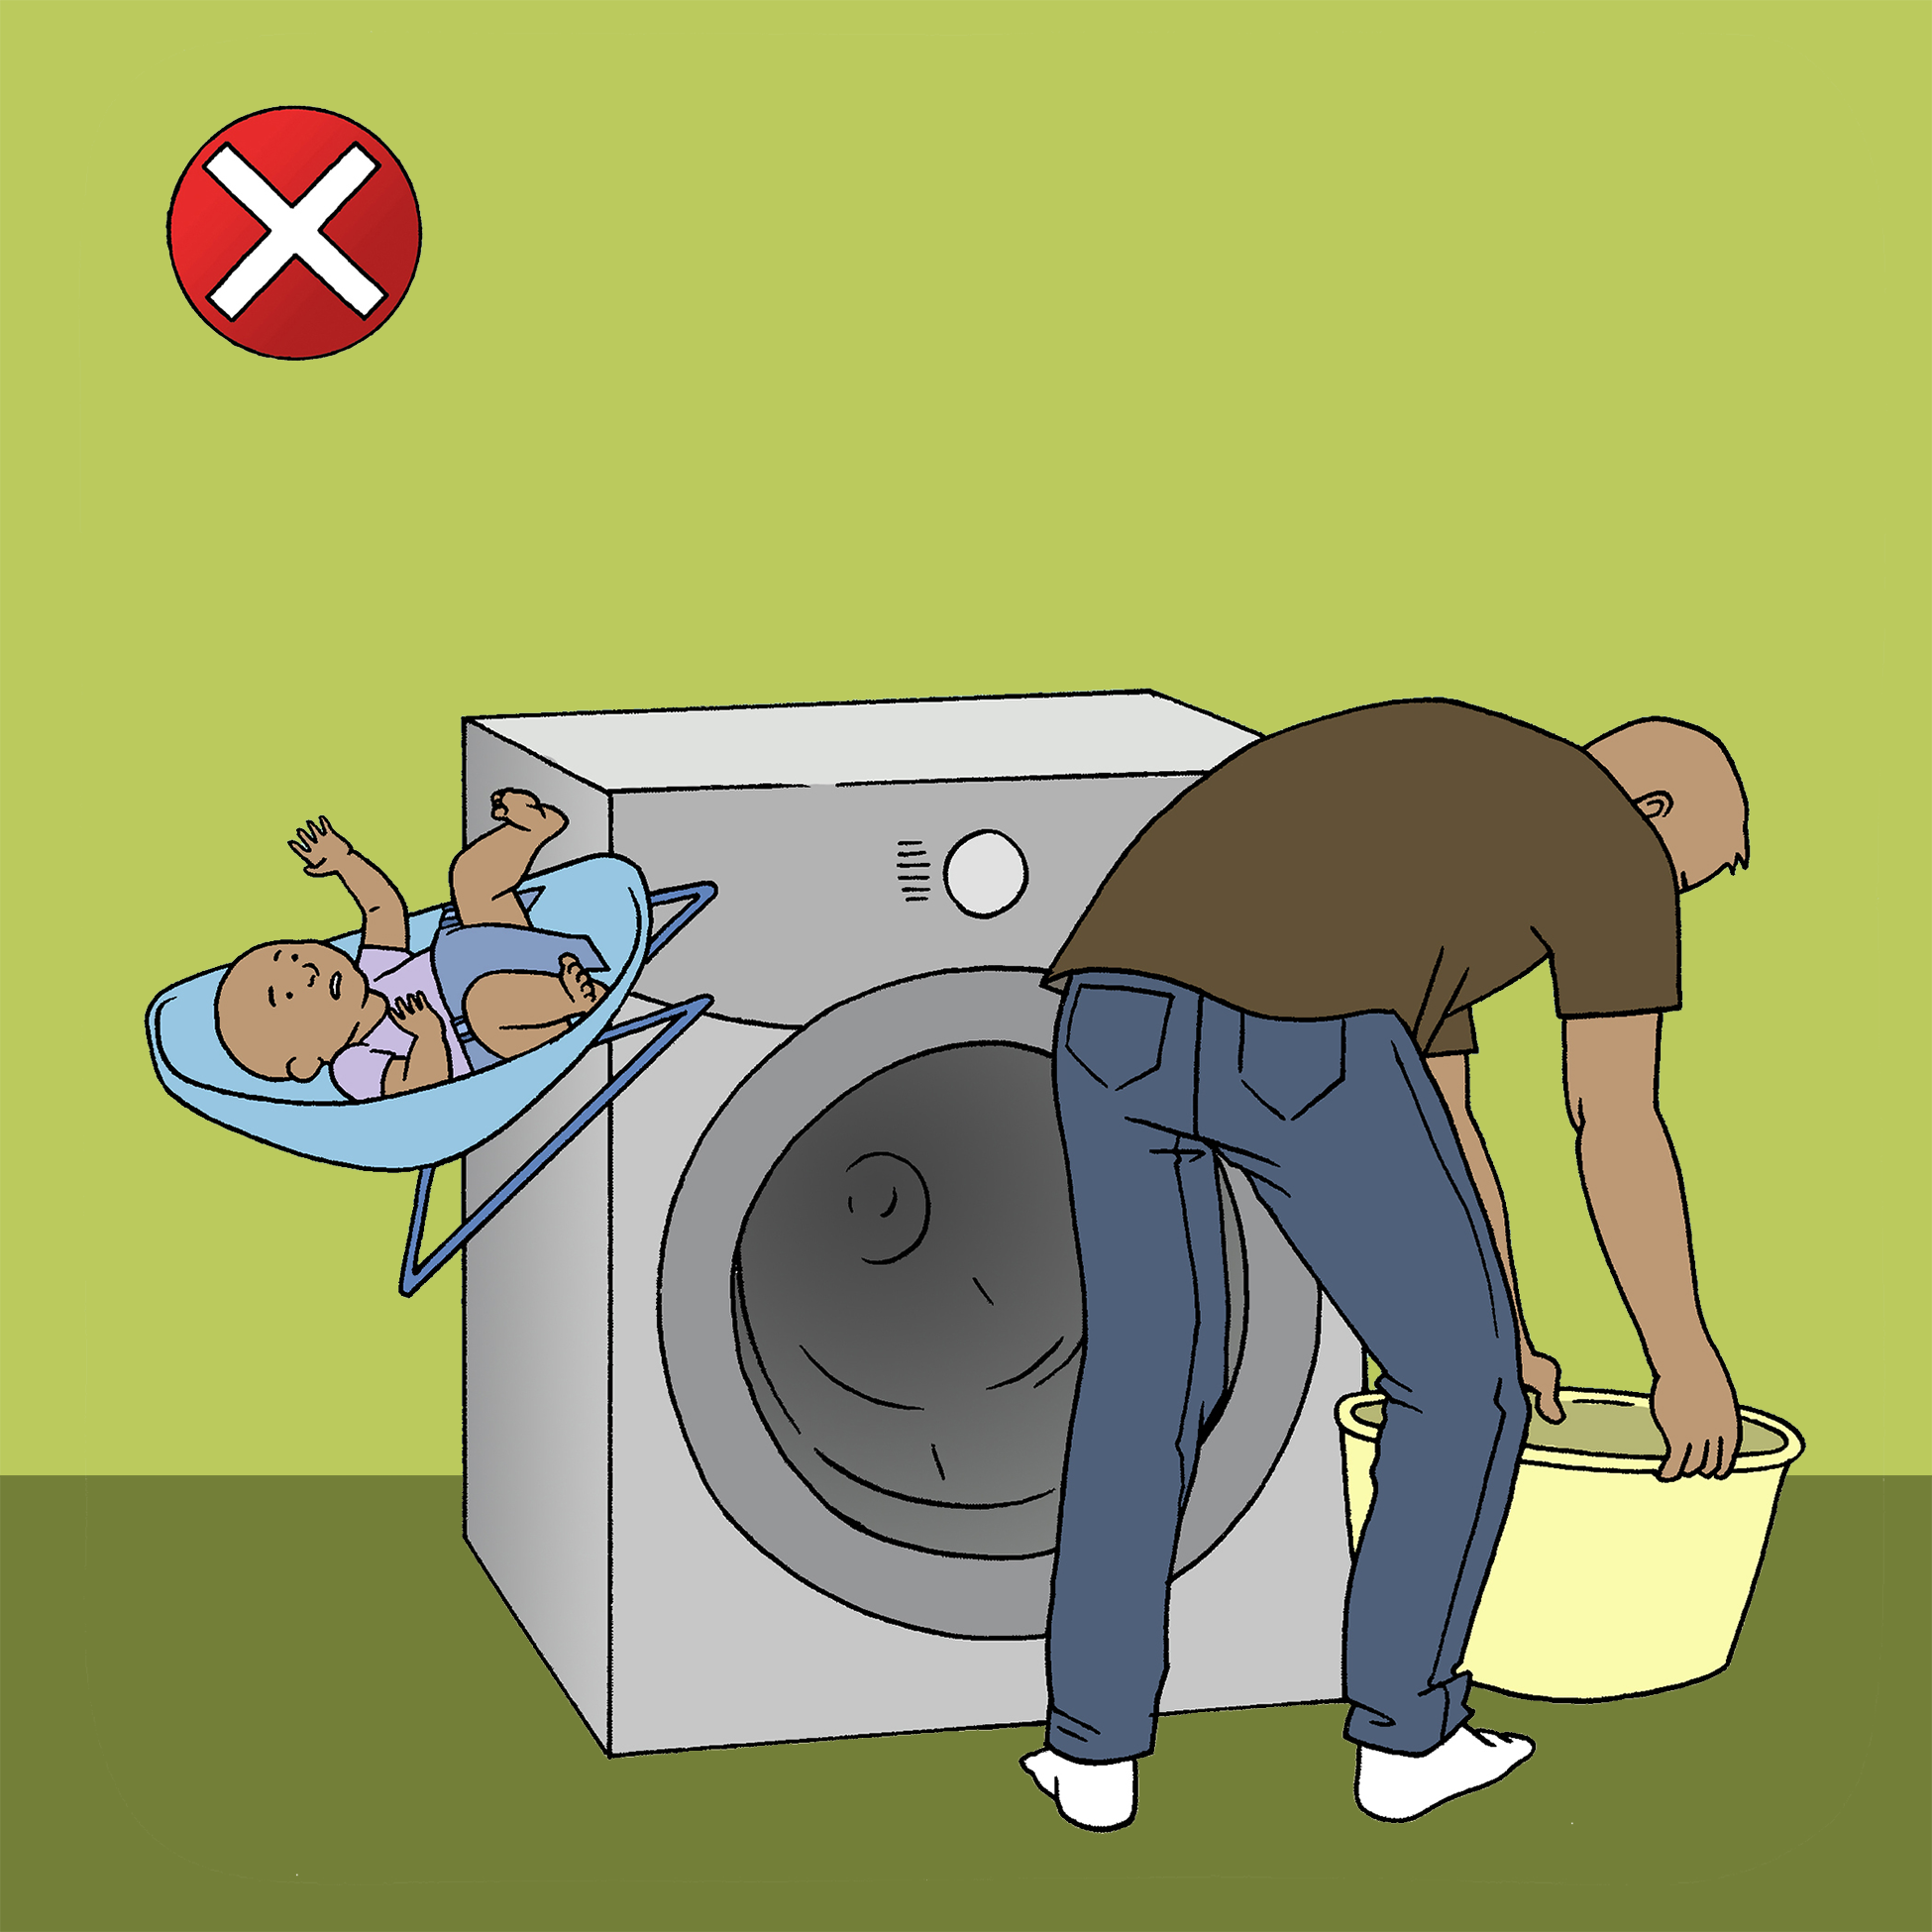
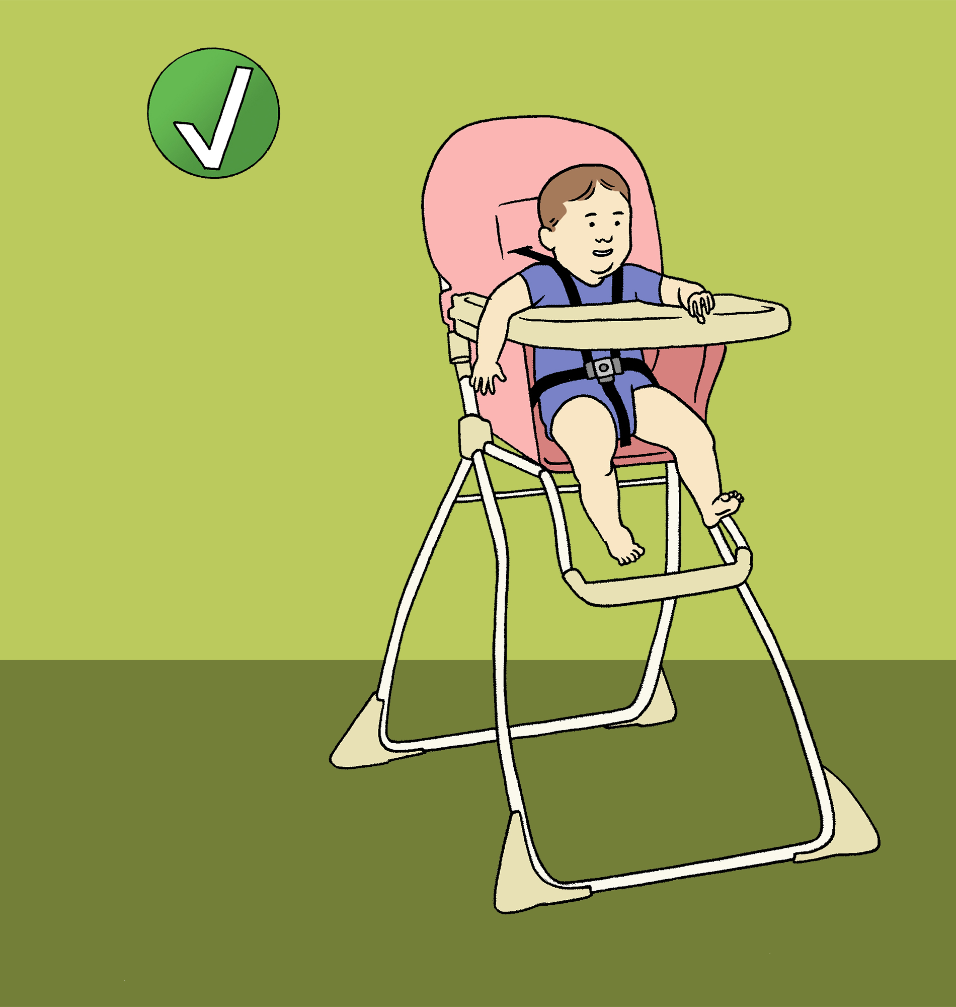
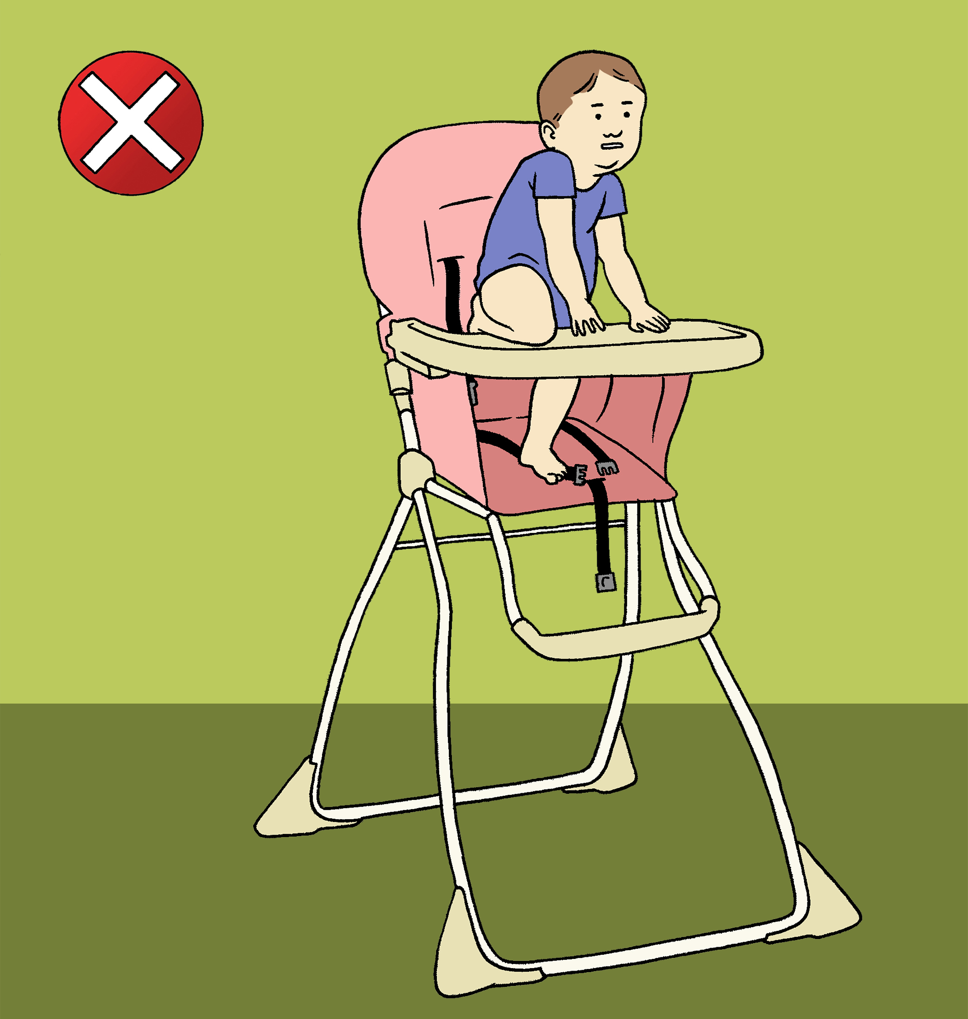
Baby Equipment & Furniture Falls: Prevention
Keep one hand on your child while on the changing table
Keep the baby carrier, bouncer, and other equipment on the floor
Use the provided safety straps with baby equipment
Sources:
https://www.cpsc.gov/s3fs-public/Nursery%20Products%20Annual%20Report%202016.pdf
https://www.cnn.com/2018/09/17/health/infant-walkers-injury-parenting/index.html
https://pediatrics.aappublications.org/content/142/4/e20174332
Notes:
Prevention Practices:
-Always supervise children when in or on equipment or furniture
-Always use safety straps when children are in strollers, highchairs, and infant carriers, and on top of changing tables
-Always keep infant carrier, bouncer, and other equipment on the floor and never on top of tables or other high furniture
-Always keep one hand on your child when atop a changing table
-If your child’s crib has adjustable side rails, always keep side rails up while your child is in the crib
-Use bed rail guards
-Ensure openings in rails are small enough to prevent child from getting trapped
-Bunk beds are suitable only for children age 6 and older, and should have safety rails on both sides with gaps between rails 4 inches or less
-Do not use baby walkers, as they do not have features to prevent falls; the American Academy of Pediatrics has called for a ban on baby walkers
Graphics taken from:
https://parachute.ca/en/injury-topic/fall-prevention-for-children/
Information taken from:
https://www.cpsc.gov/s3fs-public/Nursery%20Products%20Annual%20Report%202016.pdf
https://www.cnn.com/2018/09/17/health/infant-walkers-injury-parenting/index.html
https://pediatrics.aappublications.org/content/142/4/e20174332
Additional Points on Baby Walkers:
-Baby walkers are discouraged by the American Academy of Pediatrics
-As an alternative, use a stationary activity saucer or activity center to promote movement

Slide 14
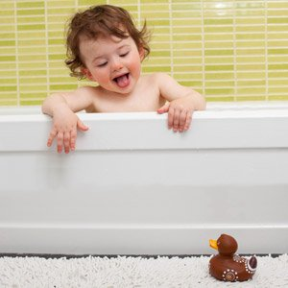
Bathtub & Slippery Surface Falls
Over 43,000 children were treated annually for bathtub- and shower-related injuries between 1990 and 2007
More than 80% of injuries involved a slip, trip, or fall
Source: https://pediatrics.aappublications.org/content/124/2/541.long
Notes:
Supervision is critical at all times when a child is in the tub or shower.
Information taken from:
https://pediatrics.aappublications.org/content/124/2/541.long
Photo taken from:
https://www.news24.com/parent/Baby/Toddler_1-2/health_safety/Caution-Kid-in-bathroom-20090813

Slide 15
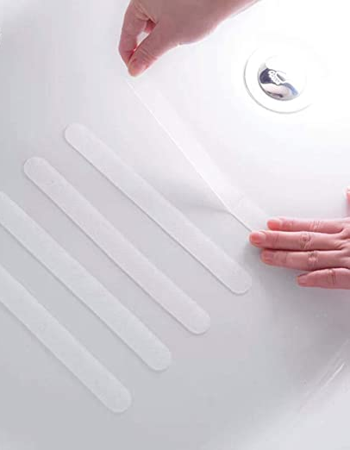
Bathtub & Slippery Surface Falls: Prevention
Use decals on the bottom of bathtubs to prevent slips
Use nonslip mats on the bathroom floor, and nonslip rugs
Wipe up spilled water from the floor immediately
Supervise children in the bathtub, always
Teach children to be safe around wet, dark, and paved areas, especially in cold temperatures
Source: https://pediatrics.aappublications.org/content/124/2/541.long
Notes:
Information taken from:
https://pediatrics.aappublications.org/content/124/2/541.long

Slide 16
Falls on the Go
Playground
Shopping Carts
Escalators
Tricycles

Slide 17
Playground Falls
Almost 80% of playground injuries are caused by falls
Each year, nearly 200,000 children (ages 14 and under) are injured due to playground falls
Most severe playground-related injuries are due to falls
More than 10% are treated for traumatic brain injury, including concussion
Over half of all playground-related injuries occur in children ages 5 to 9
Children ages 4 and under usually suffer injuries to the face and head while older children are more likely to injure arms or hands
Sources:
https://www.healthychildren.org/English/safety-prevention/at-play/Pages/Safety-on-the-Playground.aspx
https://www.nsc.org/home-safety/safety-topics/child-safety/playgrounds
https://www.stanfordchildrens.org/en/topic/default?id=falls--injury-statistics-and-incidence-rates-90-P02974
Notes:
Each year, nearly 200,000 children ages 14 and under require treatment due to playground falls
More than 20,000 of these are treated for traumatic brain injury, including concussion
Almost 80% of playground injuries are caused by falls
Most severe playground-related injuries are due to falls
Over half of all playground-related injuries occur in children ages 5 to 9
Children ages 4 and under usually suffer injuries to the face and head while older children are more likely to injure arms or hands
Information taken from:
https://www.healthychildren.org/English/safety-prevention/at-play/Pages/Safety-on-the-Playground.aspx
https://www.nsc.org/home-safety/safety-topics/child-safety/playgrounds
https://www.stanfordchildrens.org/en/topic/default?id=falls--injury-statistics-and-incidence-rates-90-P02974
Photo taken from:
https://blog.sacramento4kids.com/best-parks-for-kids-in-sacramento/

Slide 18
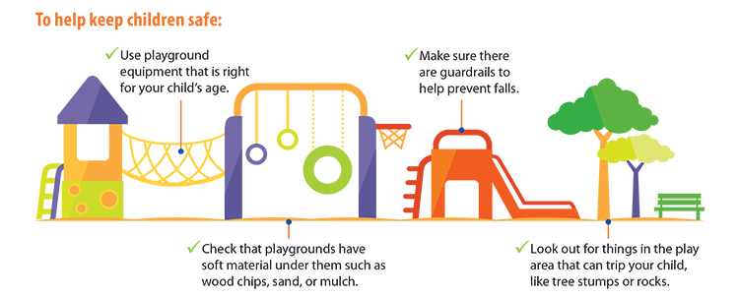
Playground Falls: Prevention
Source: https://www.cdc.gov/headsup/parents/index.html
Notes:
Prevention Practices:
-Always supervise children while playing outside due to uneven surfaces such as grass, hills, and pavement
-Seek out playgrounds with soft, shock-absorbing surfaces such as rubber, synthetic turf, sand, pea gravel, wood chips, or mulch
-Remove clothing that could pose hazards such as necklaces, purses, scarves, and drawstrings
-Teach children that pushing, shoving, and crowding on the playground is dangerous
-Encourage age-appropriate activities
-Ensure the safety of outdoor equipment (no loose parts or excessive rust)
-Additionally, avoid trampolines, as they may cause injury to your child
Information above taken from:
https://www.healthychildren.org/English/safety-prevention/at-play/Pages/Safety-on-the-Playground.aspx
https://www.nsc.org/home-safety/safety-topics/child-safety/playgrounds
https://www.stanfordchildrens.org/en/topic/default?id=falls--injury-statistics-and-incidence-rates-90-P02974
https://www.aappublications.org/news/2019/09/10/focus091019
Graphic taken from:
https://www.cdc.gov/headsup/parents/index.html

Slide 19
Shopping Cart, Escalator, & Tricycle Falls
Everyday, 66 children are treated for shopping cart injuries,
Since 2007, the CPSC reported 11,000 injuries on escalators, mostly from falls
Most emergency room tricycle-related injuries were from falls
Most tricycle-related deaths occur when children fall into swimming pools
Sources:
https://webcache.googleusercontent.com/search?q=cache:U9mXLjjNV0AJ:https://www.nationwidechildrens.org/research/areas-of-research/center-for-injury-research-and-policy/injury-topics/home-safety/shopping-cart-safety+&cd=2&hl=en&ct=clnk&gl=us
https://www.verywellfamily.com/elevator-and-escalator-hazards-2633667
https://pediatrics.aappublications.org/content/136/4/658
https://www.scientificamerican.com/article/most-tricycle-deaths-happen-when-children-fall-into-swimming-pools/
Notes:
Information taken from:
https://webcache.googleusercontent.com/search?q=cache:U9mXLjjNV0AJ:https://www.nationwidechildrens.org/research/areas-of-research/center-for-injury-research-and-policy/injury-topics/home-safety/shopping-cart-safety+&cd=2&hl=en&ct=clnk&gl=us
https://www.verywellfamily.com/elevator-and-escalator-hazards-2633667
https://pediatrics.aappublications.org/content/136/4/658
https://www.scientificamerican.com/article/most-tricycle-deaths-happen-when-children-fall-into-swimming-pools/
Note:
CPSC=U.S. Consumer Product Safety Commission
Photo taken from:
https://www.ebay.com/itm/Tricycle-Toddler-Kids-Outdoor-Bikes-Toy-3-Wheels-Big-wheel-bike-Flyer-adjustable-/383603585838

Slide 20
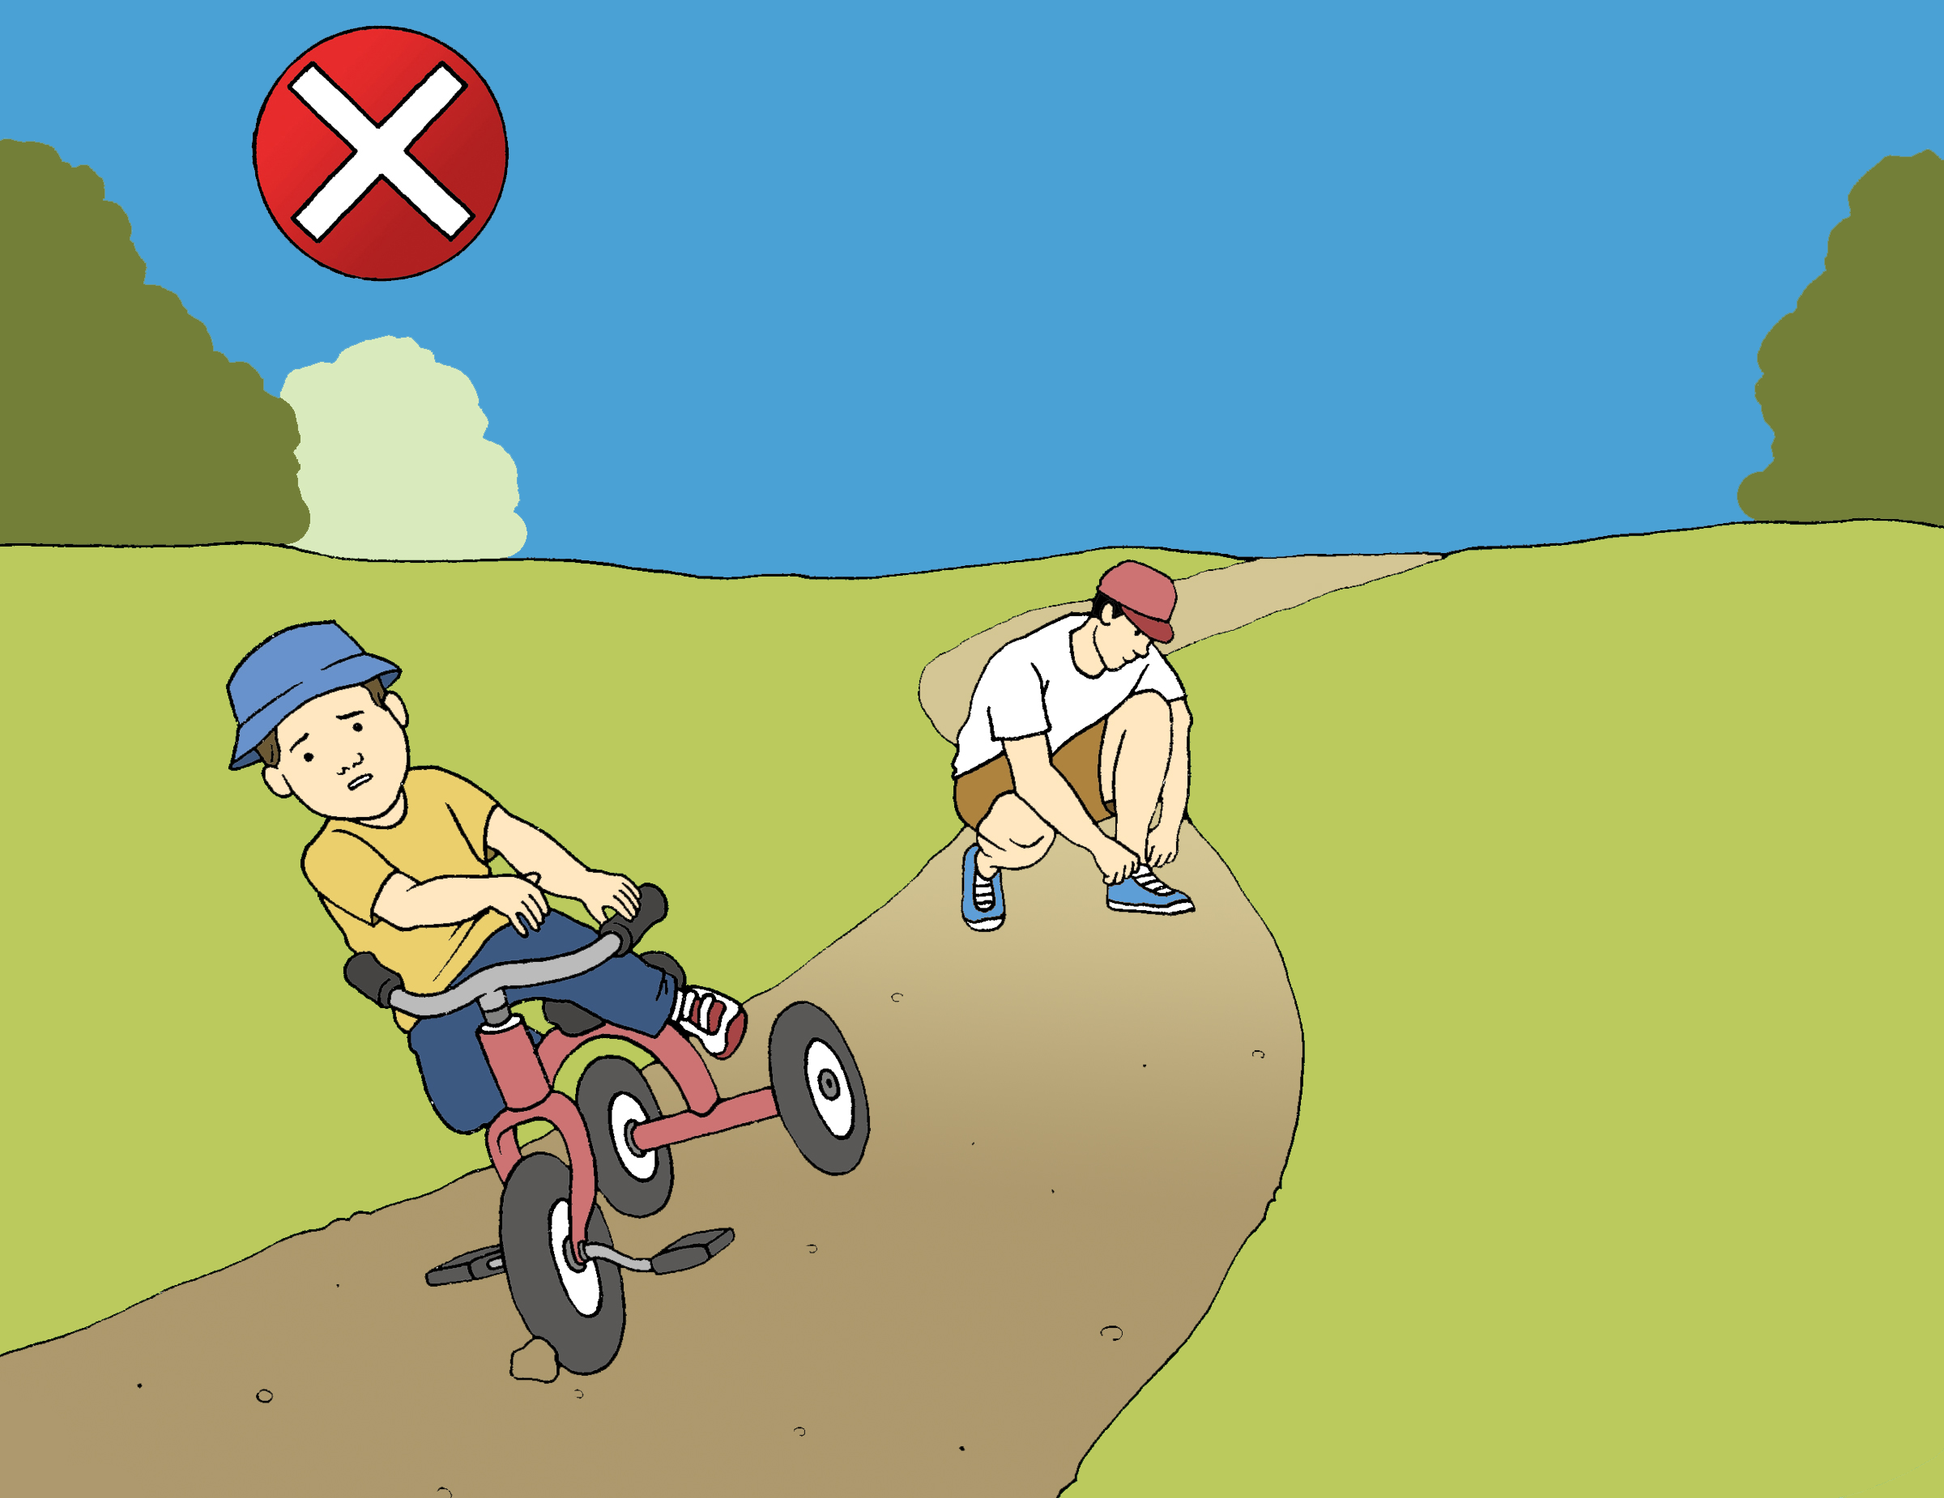
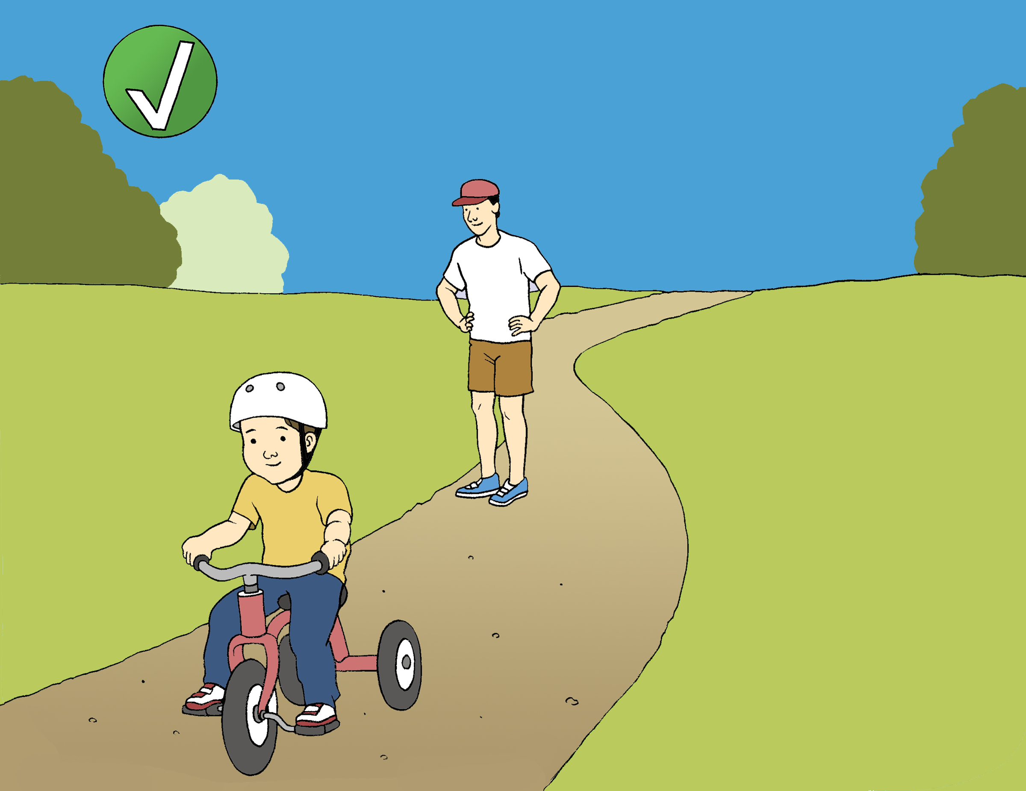
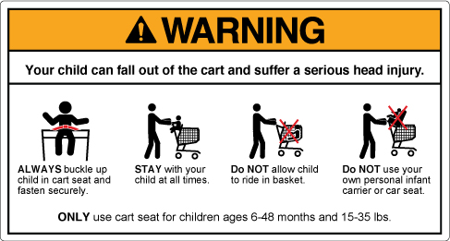
Shopping Cart, Escalator, & Tricycle Falls: Prevention
Use a harness or safety belt when your child is in a shopping cart
Use stable tricycles that are low to the ground and wear a helmet
Sources:
https://webcache.googleusercontent.com/search?q=cache:U9mXLjjNV0AJ:https://www.nationwidechildrens.org/research/areas-of-research/center-for-injury-research-and-policy/injury-topics/home-safety/shopping-cart-safety+&cd=2&hl=en&ct=clnk&gl=us
https://www.verywellfamily.com/elevator-and-escalator-hazards-2633667
https://pediatrics.aappublications.org/content/136/4/658
https://www.scientificamerican.com/article/most-tricycle-deaths-happen-when-children-fall-into-swimming-pools/
Notes:
Prevention Practices:
Shopping carts
-Always use harness or safety belt when your child is in a shopping cart, and select another cart if it is missing or broken
-Be aware that allowing children to ride in, under, on the sides, or in front of the cart can be dangerous
Escalators
-Hold child’s hand when using an escalator
-Be aware of any loose clothing that could become caught, such as shoestrings or flip flops
-Do not allow children to sit or play on an escalator
-Do not use a stroller on an escalator
Tricycles
-Only use solid, stable tricycles that are low to the ground
-Always wear a helmet
-Be aware of hills and slopes
Information taken from:
https://webcache.googleusercontent.com/search?q=cache:U9mXLjjNV0AJ:https://www.nationwidechildrens.org/research/areas-of-research/center-for-injury-research-and-policy/injury-topics/home-safety/shopping-cart-safety+&cd=2&hl=en&ct=clnk&gl=us
https://www.verywellfamily.com/elevator-and-escalator-hazards-2633667
https://pediatrics.aappublications.org/content/136/4/658
https://www.scientificamerican.com/article/most-tricycle-deaths-happen-when-children-fall-into-swimming-pools/
Photos taken from:
https://www.shoppingcartsafety.com
https://parachute.ca/en/injury-topic/fall-prevention-for-children/

Slide 21
When Your Child Falls
Signs of Serious Injury that Require Medical Attention:
Loss of consciousness
Prolonged dazedness
Broken bones, bruising, favoring an arm or leg, or not walking
Acting abnormally
Symptoms to Monitor:
While monitoring your child, seek medical care if s/he exhibits any of the following symptoms:
Sleepiness and/or difficulty waking up
Becomes irritable or easily upset and cannot be comforted
Vomits more than once
Complains of pain in head, neck, or back
Complains of increasing pain anywhere
Not walking normally
Not focusing his/her eyes normally
Exhibits any worrying behaviors or symptoms
Notes:
Information taken from:
https://kidshealth.org/en/parents/falls-sheet.html

Slide 22
Time to Take Action
If your child is not vomiting or showing any of the symptoms above, take the following actions:
Provide comfort to your child and look for any signs of injury
Place a cold compress or ice pack on any bumps and bruises
Provide children’s Tylenol for pain
Closely watch your child for the next 24 hours for signs of unusual symptoms or behavior
Call 9-1-1 and do not move your child if s/he:
May have a serious injury to the head, neck, back, hipbones, or thighs
Is unconscious
Is having difficulty breathing
Is not breathing (begin CPR if you know how)
Has a seizure
Notes:
Information taken from:
https://kidshealth.org/en/parents/falls-sheet.html

Slide 23
Fall Prevention: Safety Reminders
Supervise young children, always
2.
Have emergency phone numbers (doctor, parents, neighbors, etc.) posted
3.
Keep a first aid kit prepared and available
4.
Practice good habits with older children, when younger children are watching
5.
Be aware that objects in a child’s mouth will increase the risk of mouth injury if they fall
6.
Never move a seriously injured child
call 9-1-1 and wait for emergency responders
1.

Slide 24
Fall Prevention: Summary
Falls are the leading cause of unintentional non-fatal injuries among young children
You can prevent your child from being seriously injured from falls in the home and outside environment by following the prevention guidance provided in this presentation
At home:
Use proper baby proofing safety measures in common fall areas, such as stairs, windows, nursery furniture, and bathtubs
Be cautious of the dangers of baby walkers and use a stationary activity saucer instead
Outside environment:
Always supervise children on playground equipment and only allow play on age-appropriate equipment
Use the safety straps or harness when using shopping carts and do not allow children to ride in the basket on stand on the sides or front of the cart
On escalators, hold hands, be careful of loose clothing, and do not use a stroller on an escalator

Slide 25
Fall Prevention: Local Resources & Contact Information
Community resources near you:
[Include county-specific and local resources here]
Thank you!

Slide 26
Fall Prevention: Additional Information
Safe Kids Worldwide Playground Safety Tips
Centers for Disease Control and Prevention Playground Safety Tips for Parents
Centers for Disease Control and Prevention HEADS UP to Brain Injury Awareness
Parachute Safe Kids Week Home Fall Proof Checklist
Safe Kids Worldwide Fall Prevention for Families with Children with Special Needs
Baby Walkers: A Dangerous Choice, from the American Academy of Pediatrics
Safe Kids Greater Des Moines Window Safety Information and Checklist
The Hannah Geneser Foundation: Window Safety
U.S. Consumer Product Safety Commission Home Playground Safety Checklist
U.S. Consumer Product Safety Commission Public Playground Safety Checklist
Children's Safety Network Fall Information

Slide 27
Photo Attributions & Additional Information
Image of boy with blocks spelling “safe”: https://www.kidcheck.com/blog/kidcheck-shares-safety-tips-vbs/
Images of girl in pink & boy looking out window: https://www.safekids.org/safetytips/field_risks/falls/field_type/tip
Image of mother on stairs: https://www.lucieslist.com/guides/baby-proofing/baby-gates/
Baby walker images:
https://www.amazon.com/First-Steps-Baby-Walker-Yellow/dp/B07B8RY41D
https://www.walmart.com/ip/Baby-Walker-Anti-Rollover-Learning-Walking-Toy-Car-Free-Installation-for-Baby-6-18-Months-24in-35in-Toy-Monkey-Green/351675269
Baby equipment and furniture graphics: https://parachute.ca/en/injury-topic/fall-prevention-for-children/
Image of baby in bathtub: https://www.news24.com/parent/Baby/Toddler_1-2/health_safety/Caution-Kid-in-bathroom-20090813
Playground image: https://blog.sacramento4kids.com/best-parks-for-kids-in-sacramento/
Playground graphic: https://www.cdc.gov/headsup/parents/index.html
Tricycle image: https://www.ebay.com/itm/Tricycle-Toddler-Kids-Outdoor-Bikes-Toy-3-Wheels-Big-wheel-bike-Flyer-adjustable-/383603585838
Tricycle graphic: https://parachute.ca/en/injury-topic/fall-prevention-for-children/
Shopping cart graphic: https://www.shoppingcartsafety.com
Trampoline information: https://www.aappublications.org/news/2019/09/10/focus091019
Preventing Pediatric Falls Video: https://newsnetwork.mayoclinic.org/discussion/mayo-clinic-trauma-expert-preventing-pediatric-falls/

